Slide 1
Unit 3A
Human Form & Function
Cells, metabolism & regulation
Disruption of homeostasis

Slide 2

Study Guide
Read:
Our Human Species (3rd edtn)
Chapter 12, section 9.3; Chapter 15, section 4.5
Chapter 5, section 6
Chapter 13, section 13
Complete:
Human Biological Science Workbook
Topic 8 – Disruption of Homeostasis

Slide 3
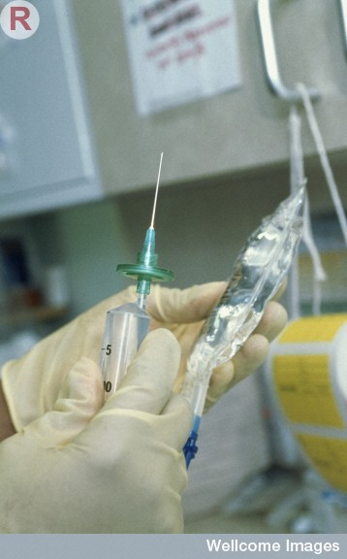
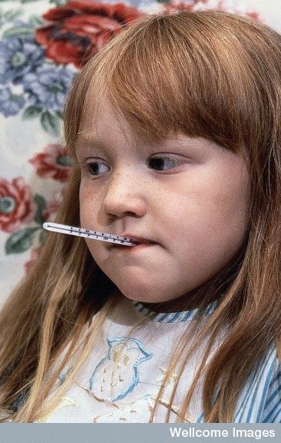
What happens if homeostasis fails?
If homeostasis cannot be maintained within tolerance limits, our body cannot function properly – consequently, we are likely to get sick and may even die.
Wellcome Photo Library

Slide 4
Example 1
Disruption resulting from
hormonal imbalance

Slide 5
Diabetes
Diabetes is a disease characterised by abnormally high levels of blood glucose.
Diabetes results from the body being unable to maintain the blood sugar level in homeostatic balance.

Slide 6
Terminology
Insulin – hormone that lowers blood glucose
Glucagon – hormone that raises blood glucose
Glucose – simple carbohydrate (basic carbohydrate building block)
Glycogen – complex carbohydrate (stored in liver & muscles)
Glycogenesis – formation of glycogen from glucose
Glycogenolysis – break down of glycogen to glucose
Gluconeogenesis – formation of glucose from breakdown of lipids or protein
Lipogenesis – formation of fats from carbohydrate
Glycaemia – blood glucose level

Slide 7
Normal regulation of high blood glucose levels
Stimulus - Blood glucose above threshold (>90mg/dl)
Receptor - Beta-cells in Islets of Langerhans (Pancreas)
Transmission - Beta cells secrete hormone insulin
Effectors - Skeletal muscles and liver
Response
Skeletal muscles – increased uptake of glucose
Liver – glucose converted to glycogen

Slide 8
Glycogenesis
High blood
glucose
Beta cells
(pancreas)
Reduced
level of
blood glucose
Receptor
Stimulus
Beta cells
Secrete
insulin
Feedback
Response
Effector
Glycogenesis
Increased glucose uptake
Lipogenesis
Liver
Somatic cells

Slide 9
Normal regulation of low blood glucose levels
Stimulus - Blood glucose below threshold (<90mg/dl)
Receptor - Alpha-cells in Islets of Langerhans (Pancreas)
Transmission - Alpha-cells secrete hormone glucagon
Effector - Skeletal muscles, liver and fat
Response
Liver & Skeletal muscles –glycogen converted to glucose
Fat – increases fat mobility

Slide 10
Glycogenolysis
Low blood
glucose
Alpha cells
(pancreas)
Increased
level of
blood glucose
Receptor
Stimulus
Alpha cells
Secrete
glucagon
Feedback
Response
Effector
Glycogolysis
Liver

Slide 11
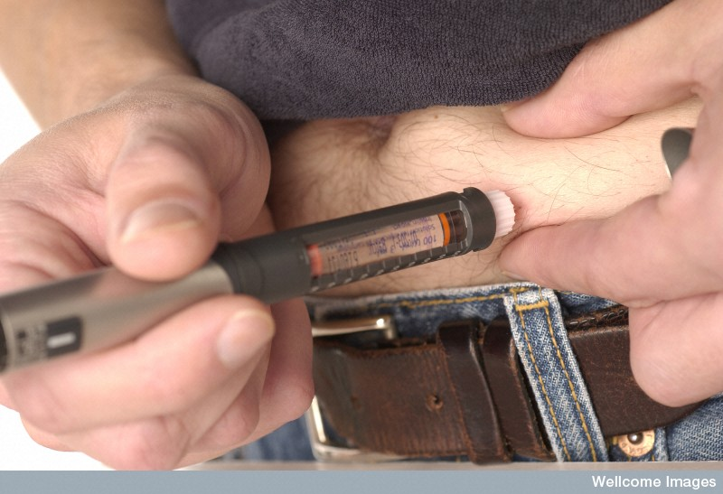
There are several different types of diabetes. The most common are:
Diabetes mellitus – Type 1
Diabetes mellitus – Type 2
Neither form of diabetes can be cured; however, both types can be managed through diet, exercise and the use of insulin.
Wellcome Library

Slide 12
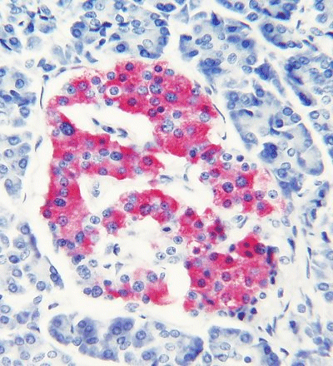
Diabetes mellitus – Type 1
Also known as early onset diabetes because it often occurs in young people under the age of 30.
Occurs because the pancreas stops making insulin.
Treated with daily injections of insulin.
Life-threatening if untreated.
An islet of Langerhans

Slide 13
Diabetes mellitus – Type 2
Also known as late onset diabetes because it typically occurs in older people under the age of 30.
Type 2 is the most common form of diabetes (85-90%).
Occurs because the body cells become less responsive to insulin.
Treated by dietary control, exercise and insulin injections.
Life-threatening if untreated.

Slide 14
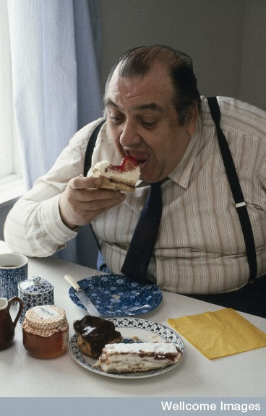
Symptoms of diabetes
Hyperglycaemia
Being excessively thirsty
Passing more urine
Feeling tired and lethargic
Always feeling hungry
Having cuts that heal slowly
Itching, skin infections
Blurred vision
Weight change (Type 1 – weight loss, Type 2 – weight gain)
Anthea Sieveking, Wellcome Images

Slide 15
Problems that arise if homeostasis is not restored
High levels of blood sugar can damage blood vessels. This can lead to:
Blindness
Kidney failure
Cardiovascular disease
Loss of sensation
Ulcers and gangrene sometimes requiring amputation of the toes or foot.

Slide 16
Ketoacidosis
People with type 1 diabetes cannot use glucose as an energy source so their body burns fat and proteins instead.
Toxic compounds called ketones are a by-product (smell like nail polish remover on the breath).
If ketones accumulate in the body a life-threatening condition known as ketoacidosis can result.

Slide 17
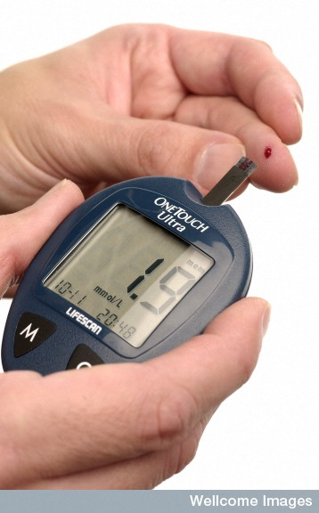
If ketoacidosis remains untreated it results in total homeostatic disruption, followed by coma and death.
A man with diabetes using an electronic reader to measure the level of sugar in his blood.
Wellcome Library

Slide 18
Example 2
Disruption resulting from
behaviour

Slide 19
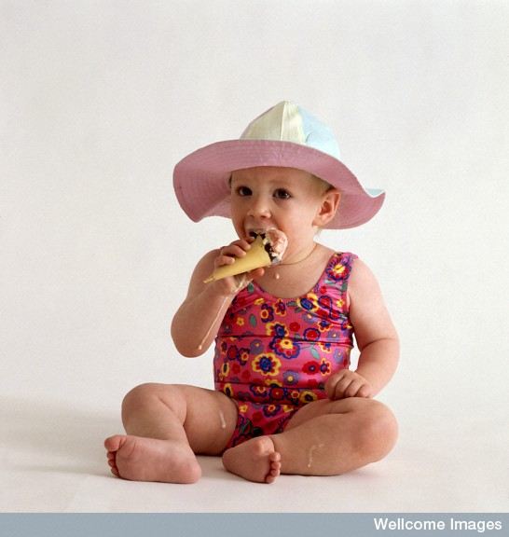
If body temperature is not maintained in the thermoneutral zone homeostasis is disrupted resulting in heat stress, and possibly death.
Anthea Sieveking, Wellcome Images

Slide 20
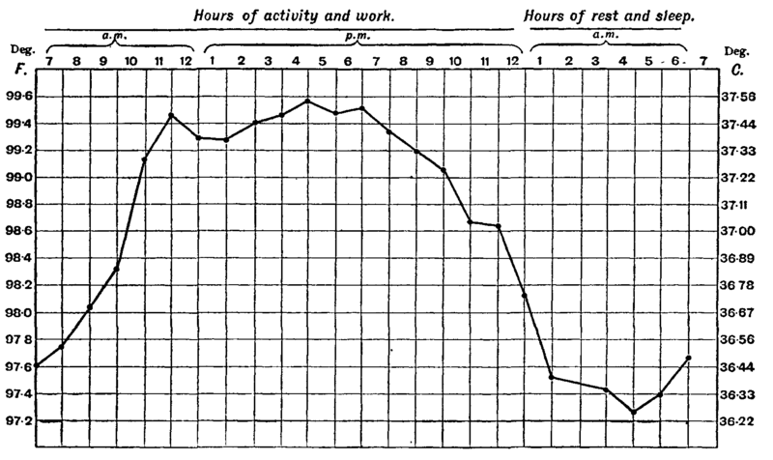
Temperature ranges
The average oral temperature ranges from
36.1 ˚C to 37.8 ˚C – the average is 36.8 ˚C, though this can vary by as much as one degree over 24 hours.

Slide 21
The thermoneutral zone
The thermoneutral zone (TNZ) is the temperature range bounded by the lower critical temperature (the point at which shivering starts) and the upper critical temperature (the point at which sweating starts).
The average TNZ is around 36 ˚C to 38 ˚C.

Slide 22
Hyperthermia
Failure of the body’s homeostatic mechanisms to control body temperature within the thermoneutral zone results in hyperthermia (abnormally high body temperature).
Failure to lower the temperature results in heat stroke and, ultimately, death

Slide 23
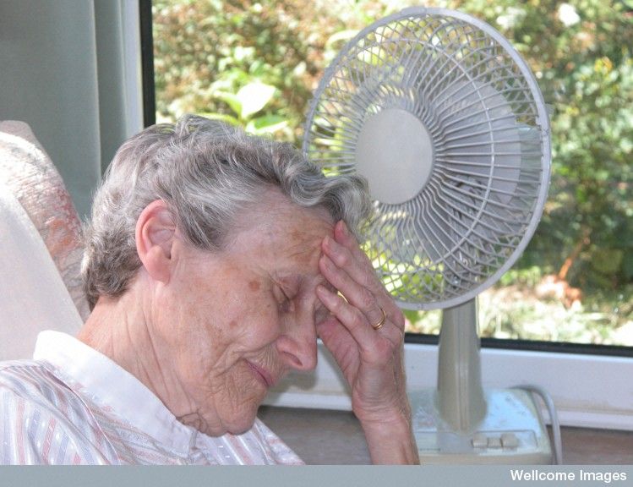
Heat exhaustion
At temperatures between 38 ˚C and 40 ˚C people sweat, become flushed and feel increasingly uncomfortable. Their heart rate increases and they may experience nausea, headache and may feel dizzy, become confused or faint.
Heat exhaustion is treated by resting in a cool area and drinking water.

Slide 24
Heat stroke
At temperatures above 41 ˚C people experience heat stroke.
The heart rate becomes very fast, sweating stops and the skin becomes dry and hot.
Beyond this point it is difficult for the body to maintain homeostatic balance and the temperature rises rapidly.
Above 42 ˚C people are likely to lapse into a coma and will die if their temperature rises above
43 ˚C - 44 ˚C.

Slide 25
Example 3
Disruption resulting from disease

Slide 26
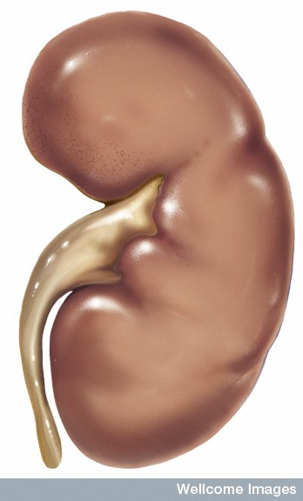
Renal failure
When the kidneys stop working homeostatic disruption is so widespread that the person will die unless they receive urgent medical assistance.
Medical Art Services, Munich, Wellcome Images

Slide 27
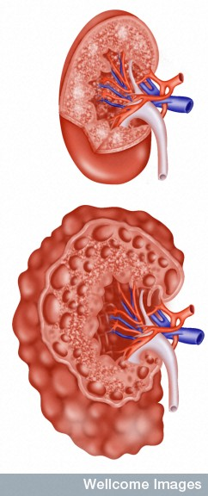
Causes of Renal failure
There are many causes for kidney failure – these can be classified as:
acute (sudden) resulting from causes such as toxic drugs, a blockage or injury.
chronic (gradual) resulting from problems such as diabetes, cancer, high blood pressure or polycystic kidney disease.
Polycystic kidney disease
Wellcome Photo Library

Slide 28
Consequences of renal failure
In both acute and chronic renal failure, urine production is disrupted and water, salts and metabolic wastes are retained in the body.
This causes widespread homeostatic problems which affect almost every system of the body.
The most common cause of death is cardiovascular disease.

Slide 29
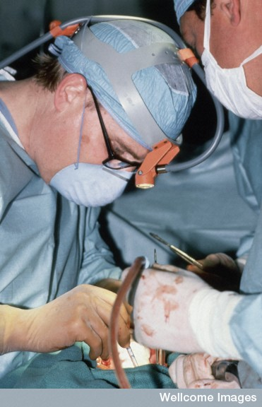
Treatment
Surgeons performing a kidney transplant
In many instances there is no cure for renal failure.
Many people with renal failure have to undergo regular haemodialysis treatment to purify their blood (conventionally three times a week).
Sometimes a kidney transplant is an option.
Wellcome Photo Library

Slide 30
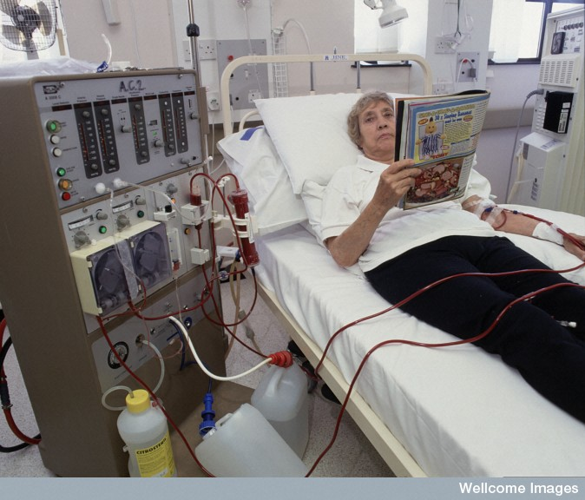
Haemodialysis
During haemodialysis blood is removed from an artery, toxic substances, metabolic wastes and excess fluid are removed, and the blood is then returned to the body
Wellcome Photo Library

Slide 31
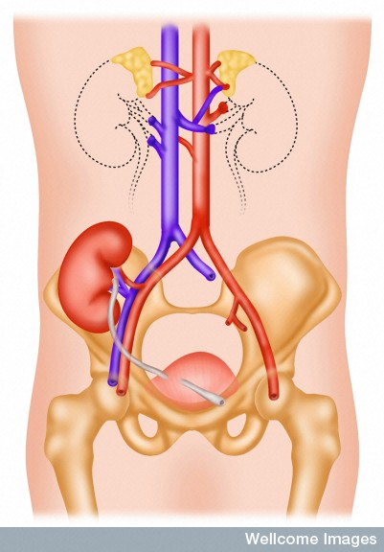
Kidney transplant
People with renal failure can receive a kidney transplant if a matching donor kidney is available.
The transplanted kidney is lower in the pelvis and attached to the common iliac artery and vein.
Wellcome Photo Library

